Slide 1
Neural Style Transfer
ICFP M2 Machine Learning – Final Presentation
Ömer Ünlüsoy, Jonathan Menssen, Jorge Cerrada
2024 - 2025

Slide 2
What is Style Transfer?
Computer Vision subfield
Extraction of the artistic style and its transfer into another image.
While preserving the semantic content [1].
Evaluation Criterion: human inspection
Main Challenge: find image representations that independently model content and style.

Slide 3
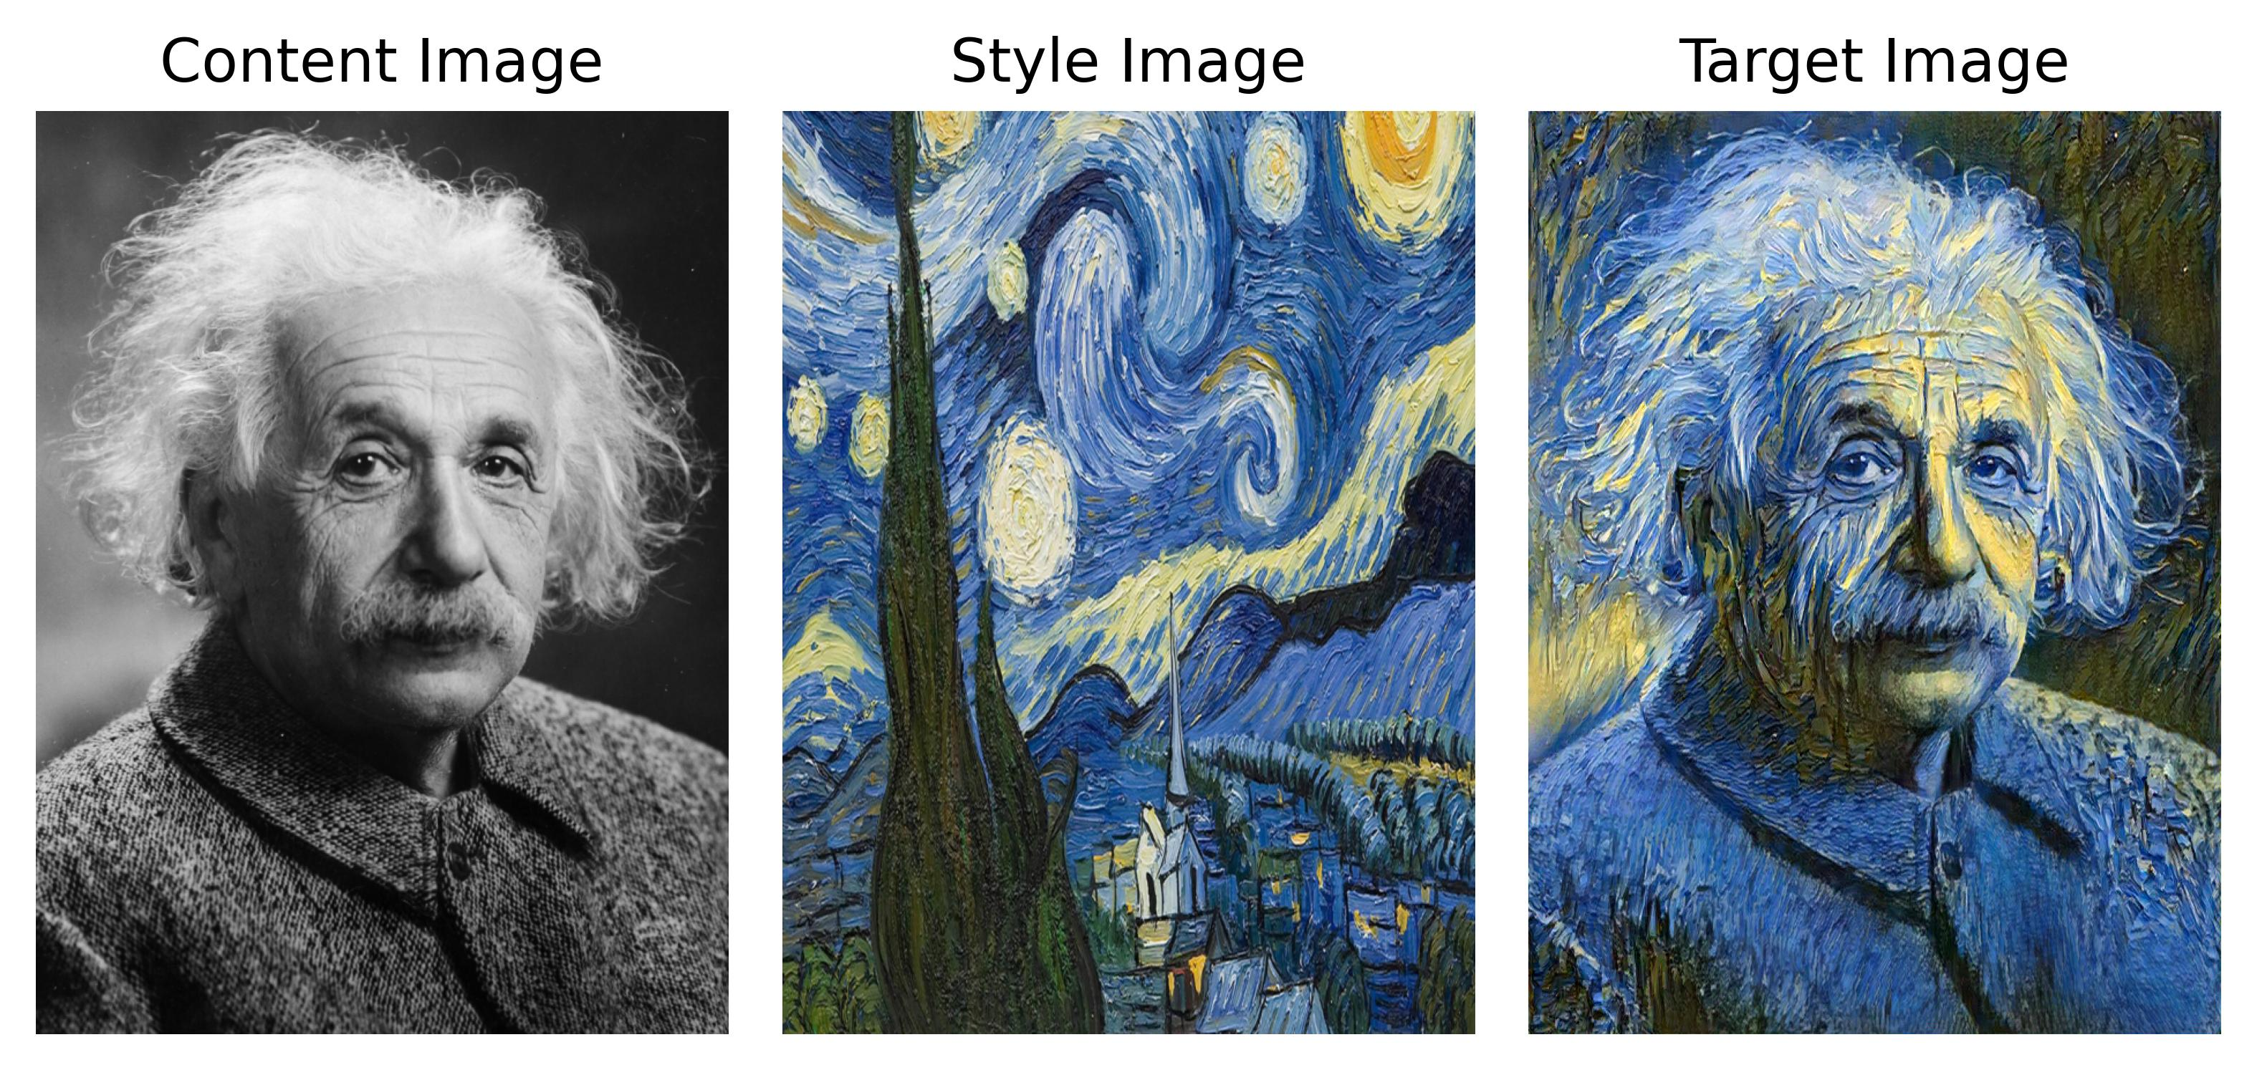
What is Style Transfer?
Figure 1: Neural Style Transfer with ‘A Neural Algorithm of Artistic Style’ algorithm (our implementation)

Slide 4
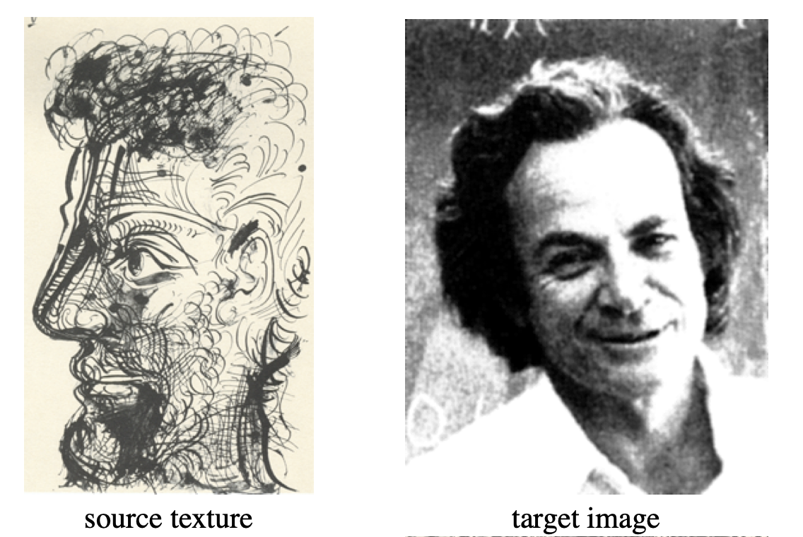
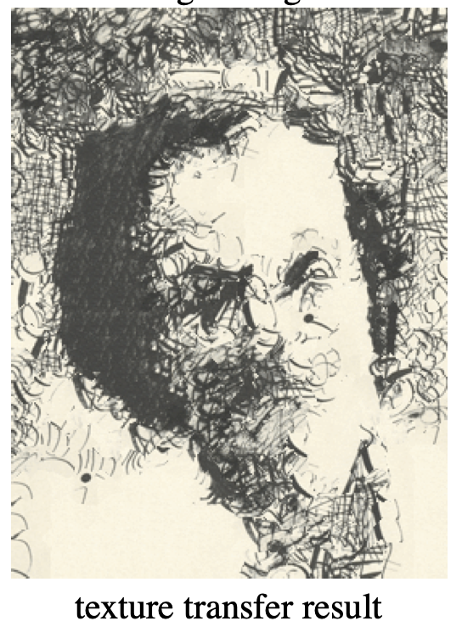
Before CNN’s
Large range of powerful non-parametric algorithms [2-5].
Limitation: only low-level content extraction
Poor separation of content from the artistic style.
Quality highly dependent on the content image.
Figure 2: Texture Transfer with Image Quilting [3]

Slide 5
Neural Style Transfer
DNNs to extract high-level semantic information.
What type of DNN?
Specifically designed for Vision
Understanding for object recognition and artistic style classification
pre-trained on sufficient labeled data
Answer: Convolutional Neural Networks (CNNs)
VGG-19 architecture pre-trained on ImageNet dataset

Slide 6
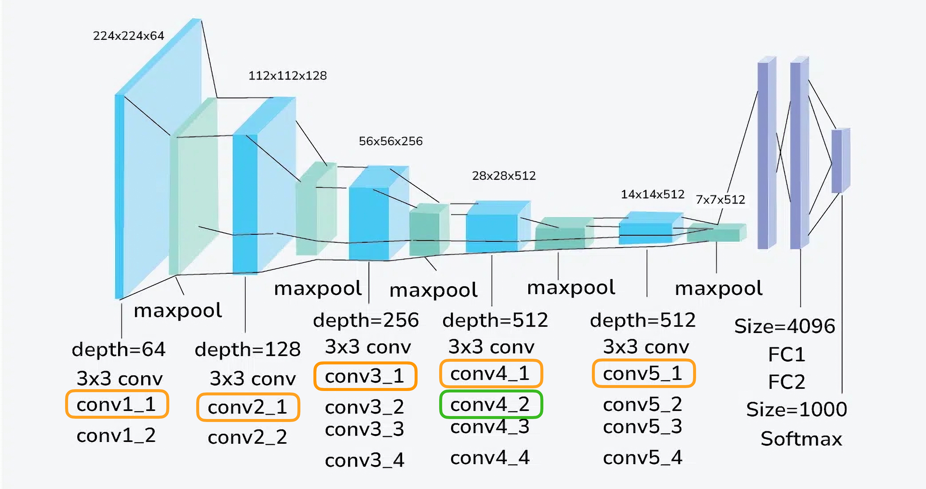
VGG-19 architecture
Figure 3: VGG-19 Architecture [6-7]

Slide 7
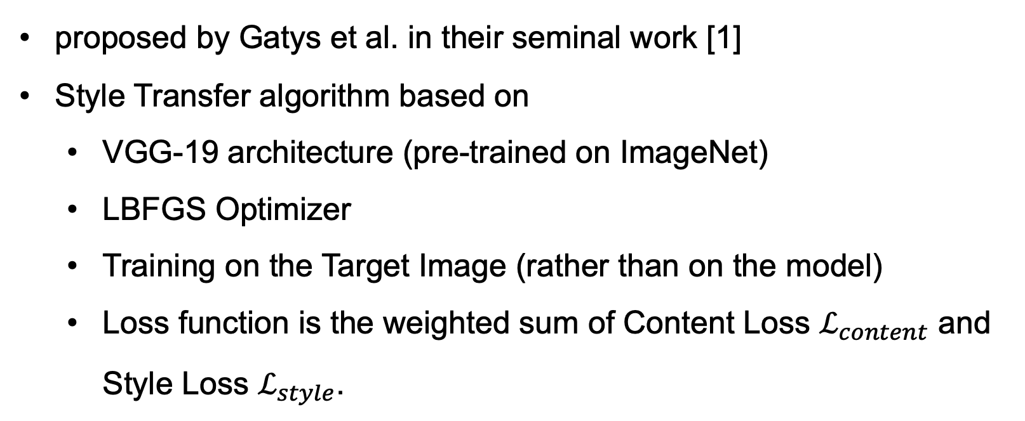
A Neural Algorithm of Artistic Style
proposed by Gatys et al. in their seminal work [1]
Style Transfer algorithm based on
VGG-19 architecture (pre-trained on ImageNet)
LBFGS Optimizer
Training on the Target Image (rather than on the model)
Loss function is the weighted sum of Content Loss $ℒ_{content}$ and Style Loss $ℒ_{style}$.

Slide 8
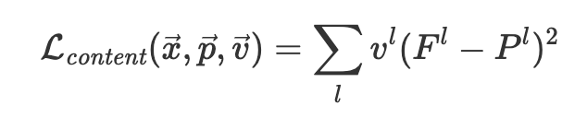
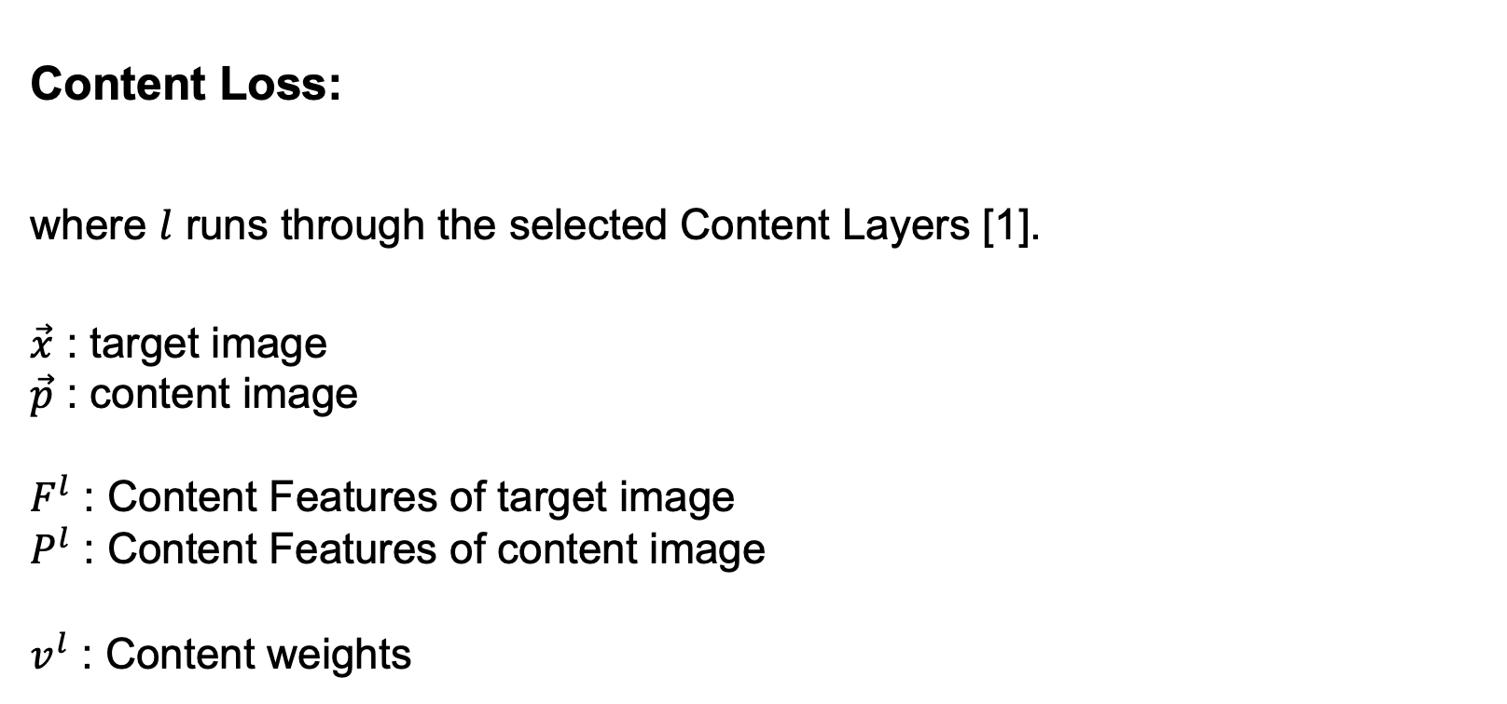
Loss function
Content Loss:
where $l$ runs through the selected Content Layers [1].
$\vec{x}$ : target image
$\vec{p}$ : content image
$F^{l}$ : Content Features of target image
$P^{l}$ : Content Features of content image
$v^{l}$ : Content weights

Slide 9
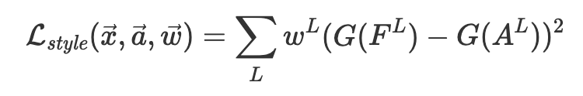
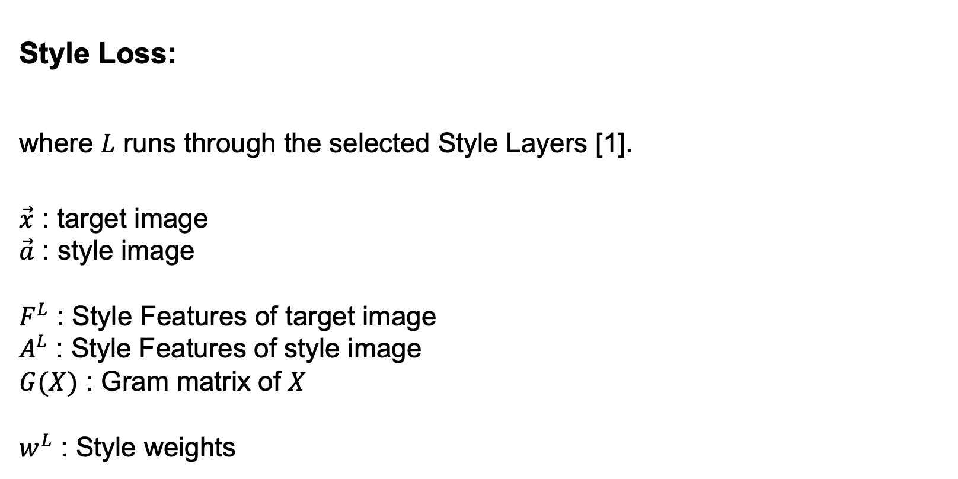
Loss function
Style Loss:
where $L$ runs through the selected Style Layers [1].
$\vec{x}$ : target image
$\vec{a}$ : style image
$F^{L}$ : Style Features of target image
$A^{L}$ : Style Features of style image
$G(X)$ : Gram matrix of $X$
$w^{L}$ : Style weights

Slide 10
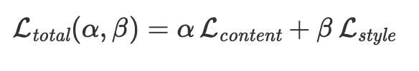
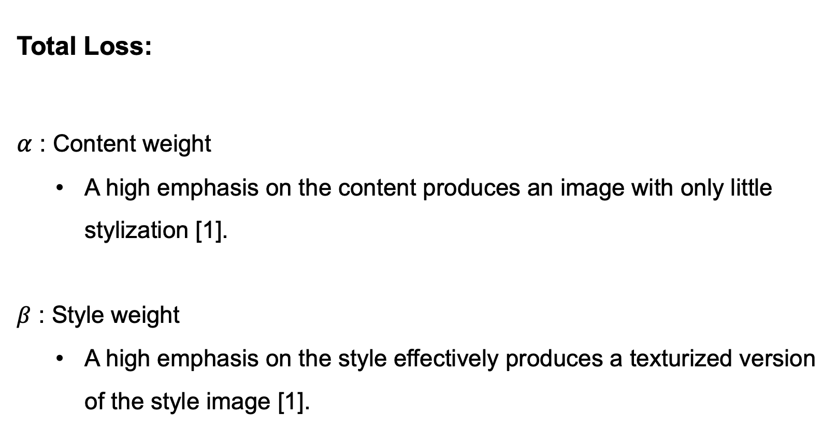
Loss function
Total Loss:
$α$ : Content weight
A high emphasis on the content produces an image with only little stylization [1].
$β$ : Style weight
A high emphasis on the style effectively produces a texturized version of the style image [1].

Slide 11
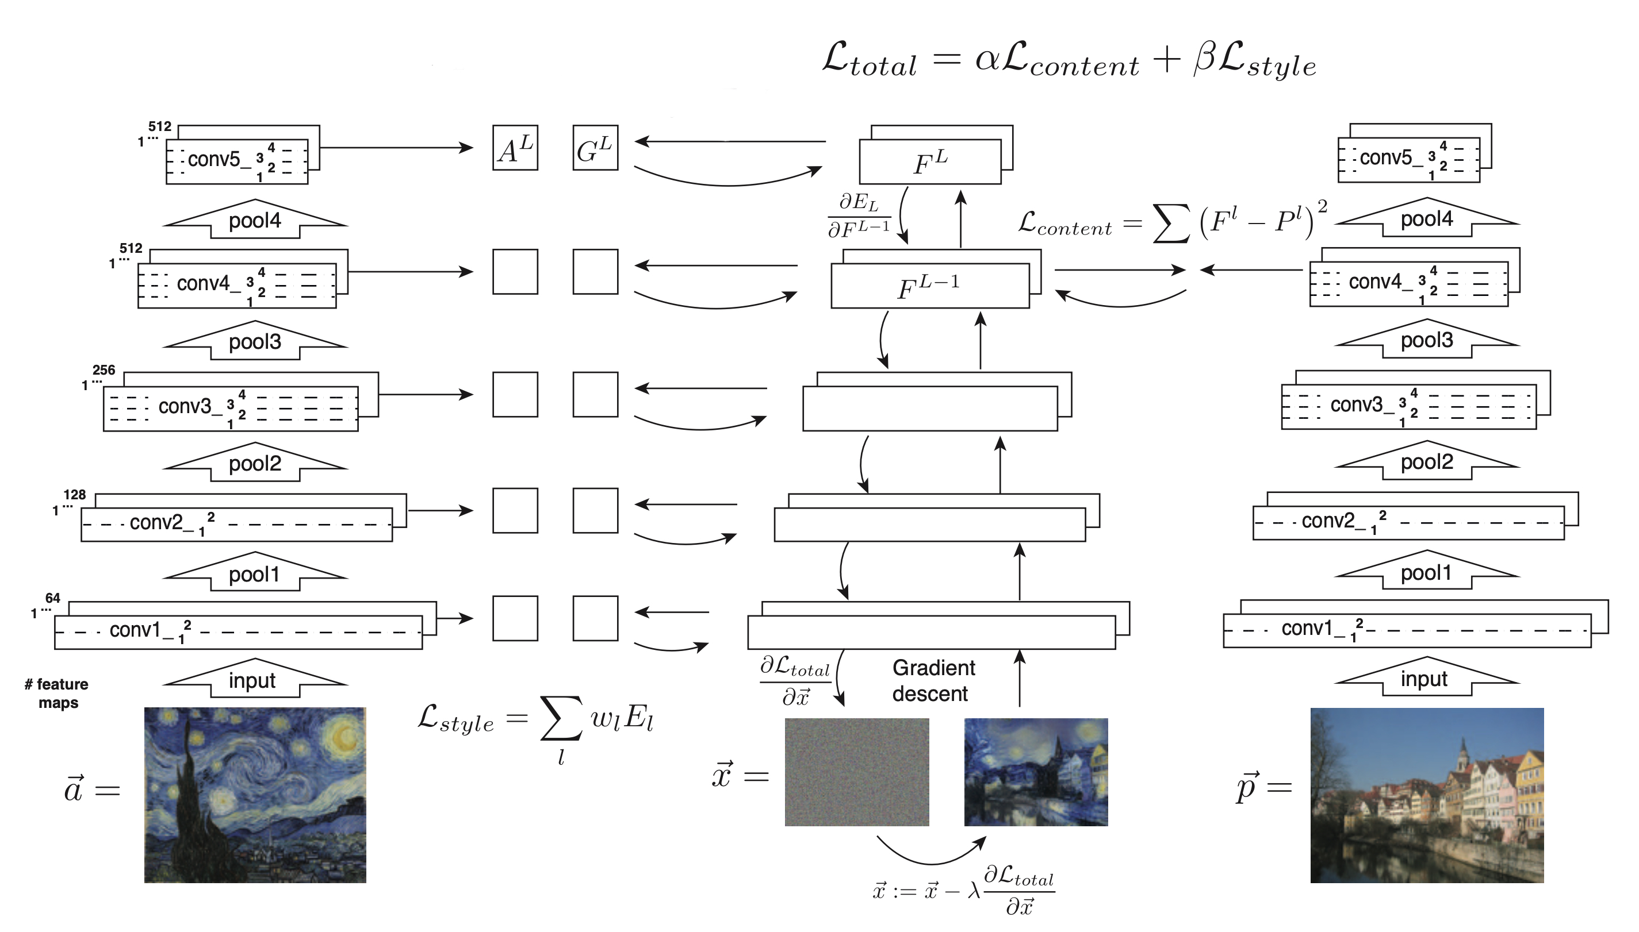
A Neural Algorithm of Artistic Style
Figure 4: ‘A Neural Algorithm of Artistic Style’ algorithm [1]

Slide 12
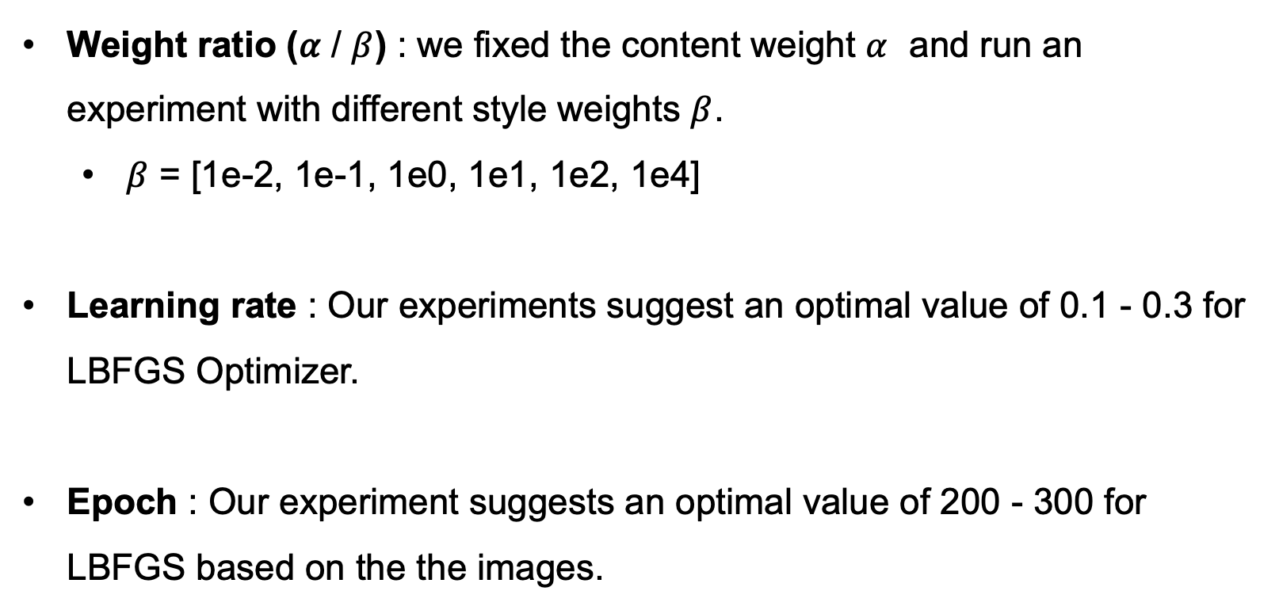
Hyperparameters
Weight ratio (𝛼 / $β$) : we fixed the content weight $α$ and run an experiment with different style weights $β$.
$β$ = [1e-2, 1e-1, 1e0, 1e1, 1e2, 1e4]
Learning rate : Our experiments suggest an optimal value of 0.1 - 0.3 for LBFGS Optimizer.
Epoch : Our experiment suggests an optimal value of 200 - 300 for LBFGS based on the the images.

Slide 13
Hyperparameters
Selected Content layers : Gatys et al. paper proposes 'conv4_2’ [1].
Content weights : Gatys et al. paper proposes 1 [1].
Selected Style layers : Gatys et al. paper proposes 'conv1_1', 'conv2_1', 'conv3_1', 'conv4_1', 'conv5_1’ [1].
Style weights : Gatys et al. paper proposes [1e3/n**2 for n in [64, 128, 256, 512, 512]] [1].

Slide 14
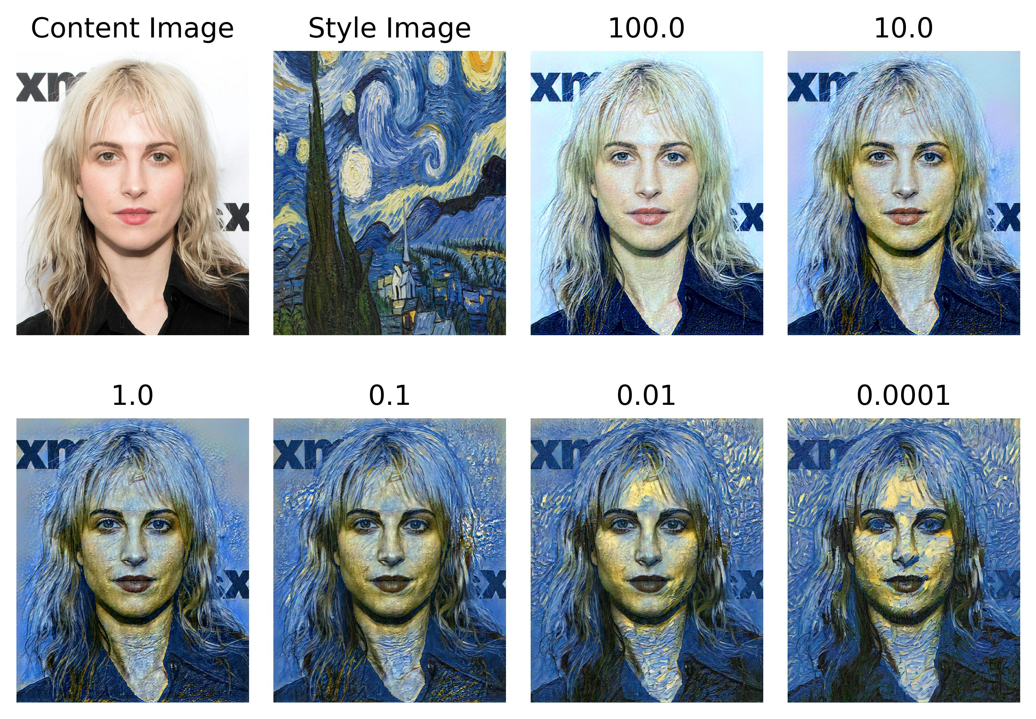
Ratio experiment
Figure 5: 𝛼 / 𝛽 weight ratio test with our implementation

Slide 15
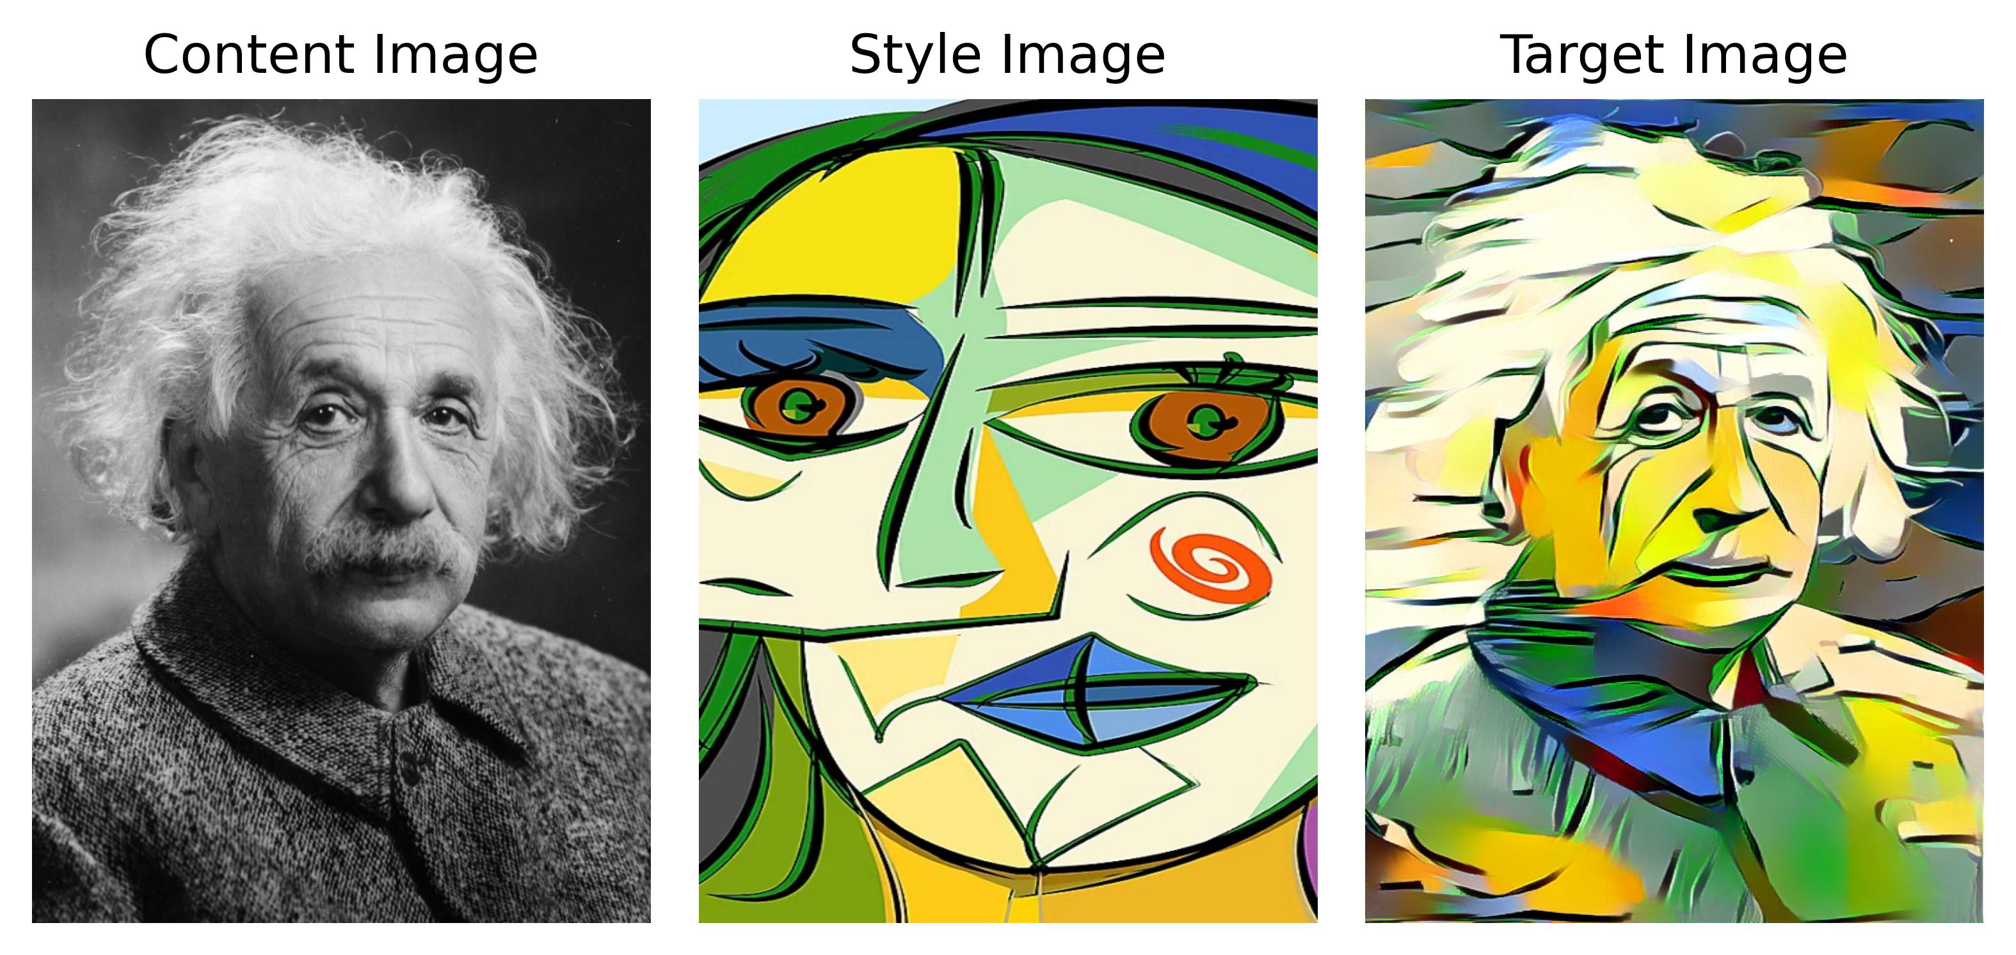
Example runs
Figure 6: Albert Einstein and Gallery of Cubism by Pablo Picasso [8] (LBFGS epoch = 200, learning rate = 0.2, style weight = 100.0)

Slide 16
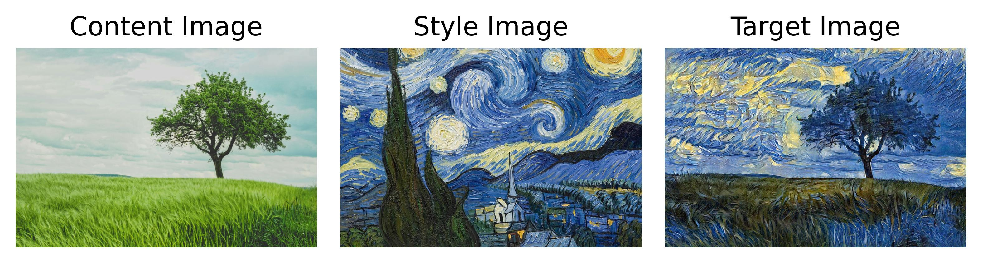
Example runs
Figure 7: Oak tree and The Starry Night by Vincent van Gogh (LBFGS epoch = 200, learning rate = 0.2, style weight = 100.0)

Slide 17
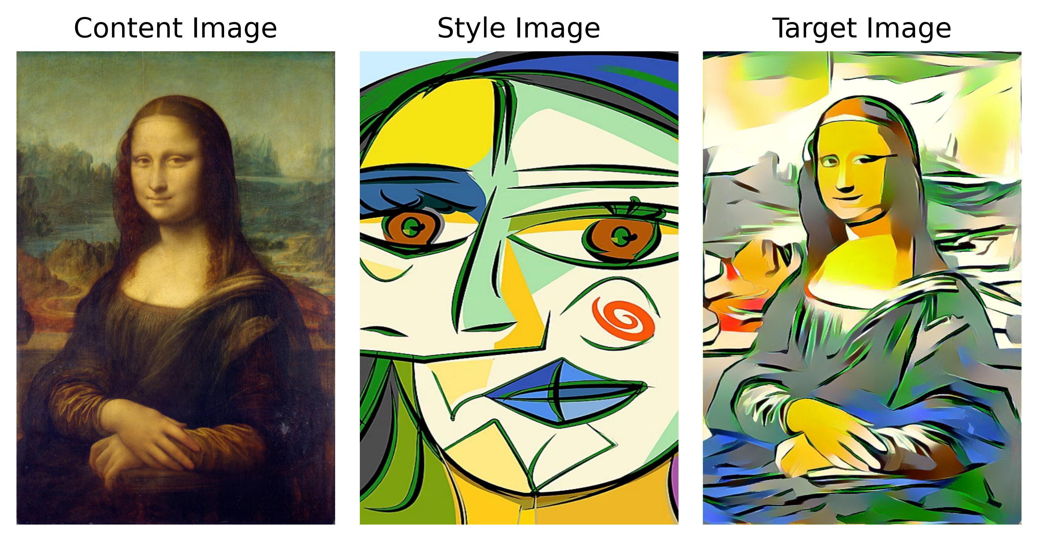
Example runs
Figure 8: Mona Lisa by Leonardo da Vinci and Gallery of Cubism by Pablo Picasso [8] (LBFGS epoch = 200, learning rate = 0.2, style weight = 100.0)

Slide 18
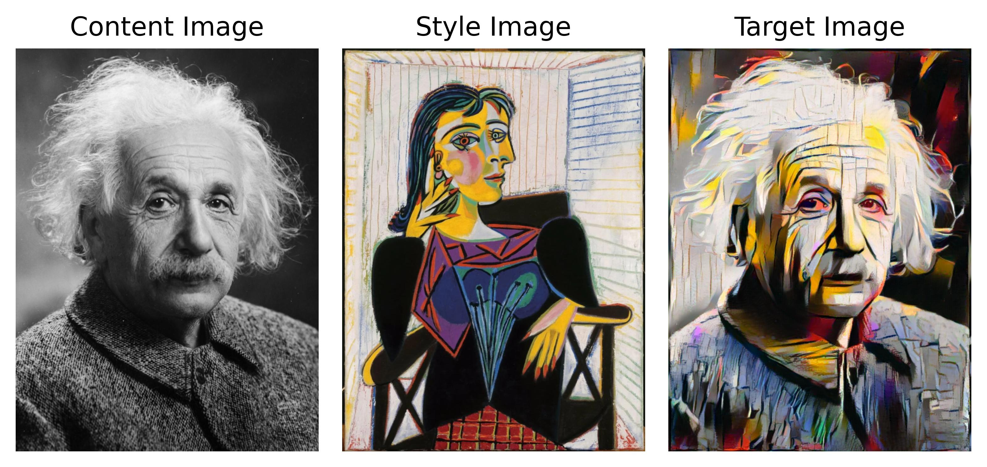
Example runs
Figure 9: Albert Einstein and Portrait of Dora Maar by Pablo Picasso [9] (LBFGS epoch = 200, learning rate = 0.2, style weight = 100.0)

Slide 19
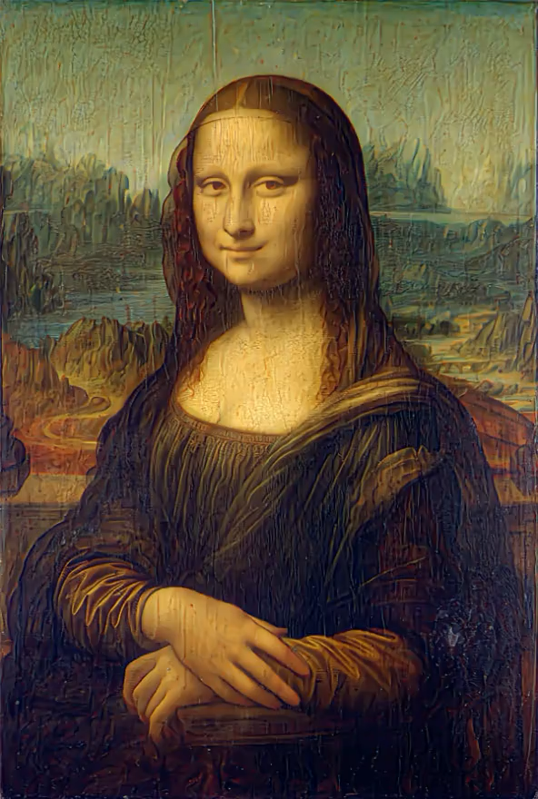
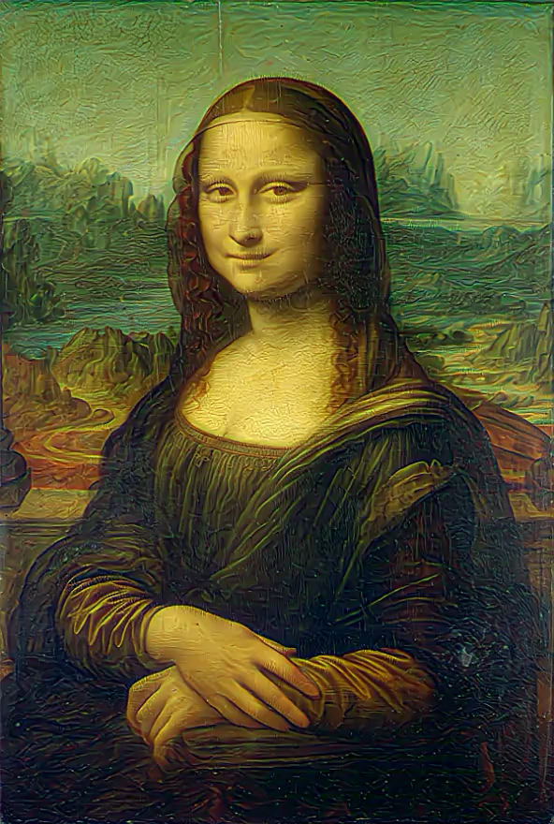
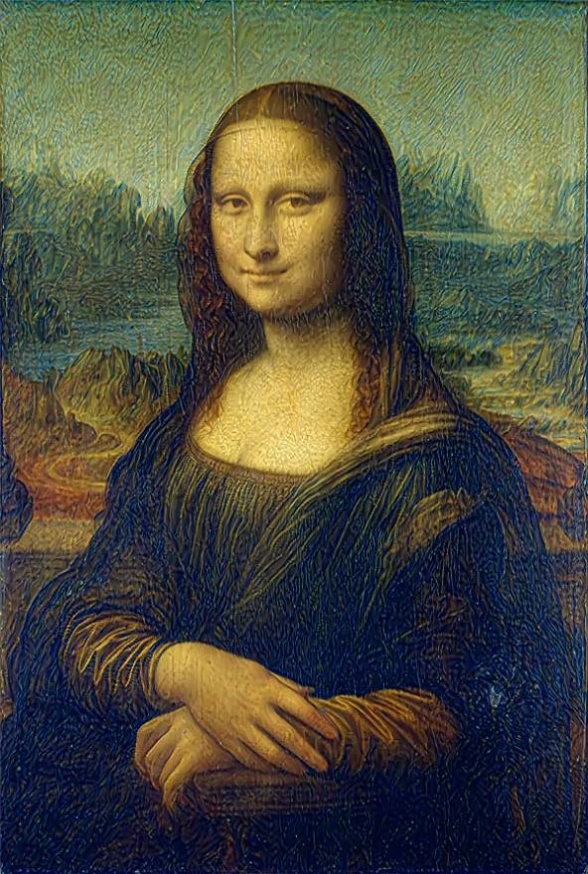
Example runs
Video 10: Mona Lisa training videos (LBFGS epoch = 200, learning rate = 0.2, style weight = 100.0)

Slide 20
results
Key Finding: Representations of content and style in the CNNs are well separable [1].
Trade-off exists between content and style matching.
requires fine adjustment to weight ratio
Results may be highly subjective.
human inspection as the sole evaluation criteria
Fascinating to see CNNs, designed for object classification, can understand the semantic content independently from artistic style.

Slide 21
References
[1] L. A. Gatys, A. S. Ecker and M. Bethge, "Image Style Transfer Using Convolutional Neural Networks," 2016 IEEE Conference on Computer Vision and Pattern Recognition (CVPR), Las Vegas, NV, USA, 2016, pp. 2414-2423, doi: 10.1109/CVPR.2016.265.
[2] A. Efros and T. K. Leung. Texture synthesis by non-parametric sampling. In Computer Vision, 1999. The Proceedings of the Seventh IEEE International Conference on, volume 2, pages 1033–1038. IEEE, 1999.
[3] A. A. Efros and W. T. Freeman. Image quilting for texture synthesis and transfer. In Proceedings of the 28th annual conference on Computer graphics and interactive techniques, pages 341–346. ACM, 2001.
[4] V. Kwatra, A. Sch¨ odl, I. Essa, G. Turk, and A. Bobick. Graphcut textures: image and video synthesis using graph cuts. In ACM Transactions on Graphics (ToG), volume 22, pages 277–286. ACM, 2003.
[5] L. Wei and M. Levoy. Fast texture synthesis using tree-structured vector quantization. In Proceedings of the 27th annual conference on Computer graphics and interactive techniques, pages 479–488. ACM Press/Addison-Wesley Publishing Co., 2000.

Slide 22
References
[6] Zheng, Yufeng & Yang, Clifford & Merkulov, Aleksey. (2018). Breast cancer screening using convolutional neural network and follow-up digital mammography. 4. 10.1117/12.2304564.
[7] Simonyan, Karen and Andrew Zisserman. “Very Deep Convolutional Networks for Large-Scale Image Recognition.” CoRR abs/1409.1556 (2014).
[8] “Gallery of Cubism by Pablo Picasso.” LatAm ARTE, www.latamarte.com/en/galleries/3kKJ/. Accessed 12 Mar. 2025.
[9] Wikipedia contributors. "Portrait of Dora Maar." Wikipedia, The Free Encyclopedia. Wikipedia, The Free Encyclopedia, 19 Feb. 2024. Web. 12 Mar. 2025.

Slide 23
Thanks for listening

